Slide 1
03 | Working with Azure DNS Services
James Chambers | @CanadianJames
Simon Timms | @stimms

Slide 2
Course Topics
Applications on Azure: Putting All the Pieces Together
01 | Intro | 05 | Storing Data and Objects in Azure
02 | Exploring Application Architecture | 06 | ElasticSearch, Docker and YOU
03 | Working with Azure DNS Services | 07 | Scaling Your Application Under Load
04 | Executing Large Tasks in the Cloud | 08 | Rewind

Slide 3
Course Topics
Applications on Azure: Putting All the Pieces Together
01 | Intro | 05 | Storing Data and Objects in Azure
02 | Exploring Application Architecture | 06 | ElasticSearch, Docker and YOU
03 | Working with Azure DNS Services | 07 | Scaling Your Application Under Load
04 | Executing Large Tasks in the Cloud | 08 | Rewind

Slide 4
Module Overview

Slide 5
Working with Azure DNS Services
DNS Basics
Configuring DNS
DNS in Azure
Programmatic DNS Management

Slide 6
DNS Basics

Slide 7
Terminology
DNS: Domain Name System
Registrar
TTL: time to live
Zones
Recordsets and records
TLD, SLD, extensions, domains, hosts

Slide 8
DNS Basics
joe.imagenomnom.com
joe
imagenomnom
com
Notes:
Top level domain – .com, .net, .org, .edu etc + country codes + specials
Second level domain - involves registrars
Third level, subdomain, host name – you typically set these

Slide 9
DNS Basics
joe.imagenomnom.com
40.112.142.148

Slide 10
Configuring DNS

Slide 11
Configuring DNS
Register a domain
Delegate name resolution
Create requisite records

Slide 12
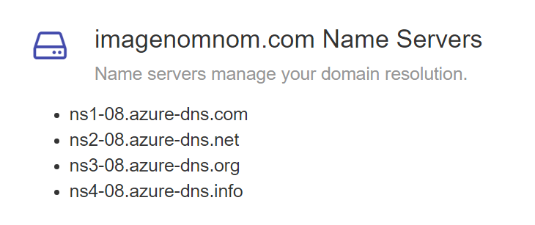
Name Resolution

Slide 13
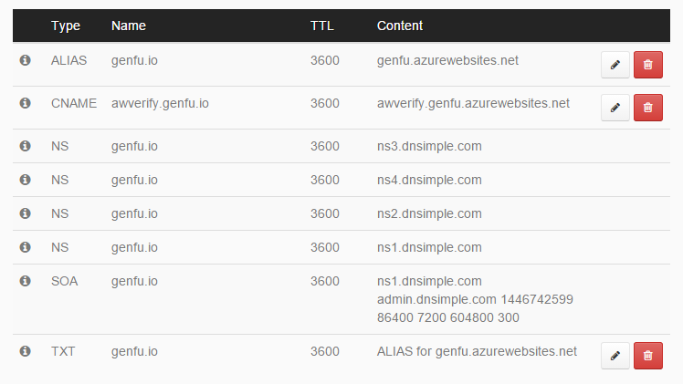
DNS Entries

Slide 14
DNS in Azure

Slide 15
When we’re not using Azure…
Services simplify DNS concerns and management
Caching can have an impact on record resolution
You usually don’t have to worry about it after setting things up

Slide 16
Our Scenario
Create entries for each registered user
Read our information from a queue
Process entries in a background process
joe.imagenomnom.com

Slide 17
Programmatic DNS Management

Slide 18
Using PowerShell

Slide 19
Using the .NET Azure SDK

